Slide 1


MS Business Analytics and Data Science
Mini Project II Submission
Term Deposit Subscription Prediction
Team – GO POKES
Team Members –
Srinivas Kotamraju
Heidi Ramzel
Vishal Tyagi
Deepak Sai Nurgoor

Slide 2





Problem Statement
The dataset provided is related to the direct marketing campaign of a Banking Institution. The campaigns were driven by telephone calls. The aim is to assess if the product (a term deposit) would be subscribed to (or not) by the customers based on a list of predictors.
Dataset Provided
Numerical Attributes
Categorical Attributes
Customer Attributes
Call Attributes
Campaign Attributes
Socio Economic Attributes
Age
Job
Marital status
Education
Loan default
Housing loan
Personal loan
Contact communication type
Last Contact month of year
Last contact day of the week
Last contact duration, in seconds
No. of contacts performed during current campaign
No. of contacts performed before the current campaign
Outcome of previous marketing campaign
Number of days passed by after the client was last contacted
Employee variation rate
Consumer price index
Consumer confidence index
Euribor 3-month rate
Number of employees
Client’s subscription to the Term Deposit Plan
Target Column
Feature Columns

Slide 3
Exploratory Data Analysis

Slide 4


Datatype of Columns
Numeric Type Columns (10 in total)
String Type Columns (11 in total)
Age
Duration
Campaign
Pdays
Previous
Emp.var.rate
Cons.price.idx
Cons.conf.idx
Euribor3m
Nr.employed
Job
Marital
Education
Default
Housing
Loan
Contact
Month
Day_of_week
Poutcome
Subscription Status (y)
Shape of the Dataset & Count of Null Values
There is a total of 41,188 rows and 21 columns in the dataset provided. Additionally, there are no NULLs in the Campaign Dataset. However, there is an “Unknown” category in some categorical columns where information was either not provided or not gathered.

Slide 5
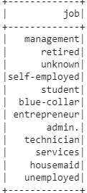
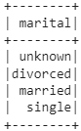
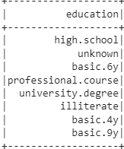
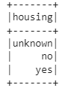
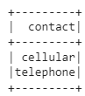
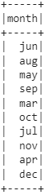
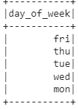
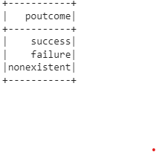
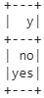
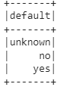
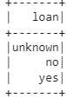
Summary Statistics for Numerical Variables
Summary | Count | Mean | Stddev | Min | Max
age | 41188 | 40.02 | 10.42 | 17.00 | 98.00
duration | 41188 | 258.29 | 259.28 | 0.00 | 4918.00
campaign | 41188 | 2.57 | 2.77 | 1.00 | 56.00
pdays | 41188 | 962.48 | 186.91 | 0.00 | 999.00
previous | 41188 | 0.17 | 0.49 | 0.00 | 7.00
emp_var_rate | 41188 | 0.08 | 1.57 | -3.40 | 1.40
cons_price_idx | 41188 | 93.58 | 0.58 | 92.20 | 94.77
cons_conf_idx | 41188 | -40.50 | 4.63 | -50.80 | -26.90
euribor3m | 41188 | 3.62 | 1.73 | 0.63 | 5.05
nr_employed | 41188 | 5167.04 | 72.25 | 4963.60 | 5228.10
Unique Values of Categorical Columns
GO POKES | Mini Project Submission

Slide 6
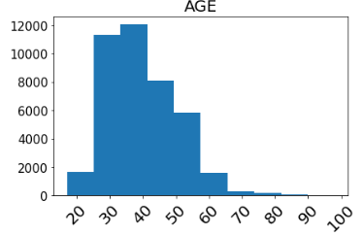
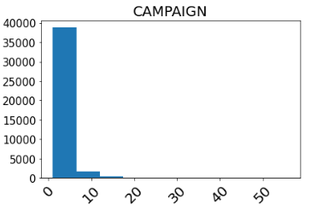
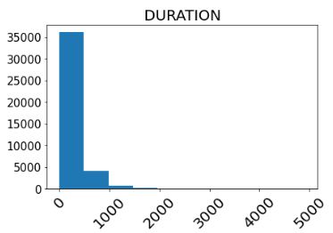
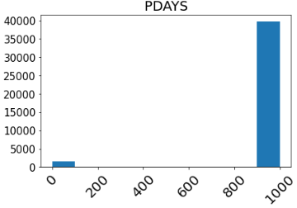
Univariate Analysis - Distribution of Feature Columns – Age, Campaign, Duration, PDays
Age is right skewed with mean centred around 35
Both campaign and duration has peaked and low range distribution
Pdays has an asymmetric distribution with values primarily concentrated in the extreme ends of the distribution
GO POKES | Mini Project Submission

Slide 7
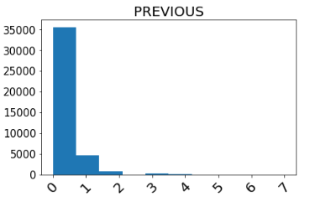
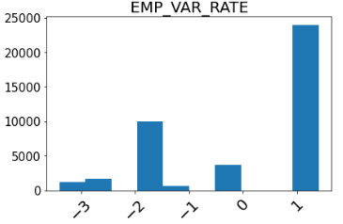
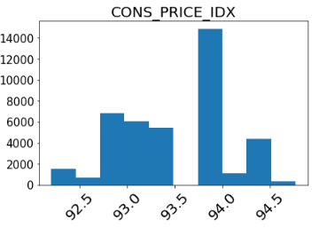
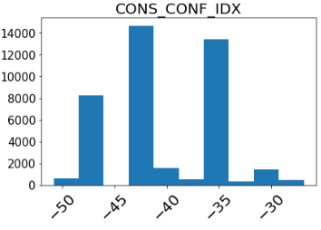
Univariate Analysis - Distribution of Feature Columns – Previous, emp_var_rate, cons_price_idx, cons_conf_idx
Previous has the most values in the range of 0 - 2
EMP_VAR_RATE and CONS_PRICE_IDX are distributed widely across the range
CONS_CONF_IDX has the most values in the range of -50 to -35
GO POKES | Mini Project Submission

Slide 8
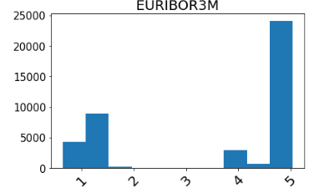
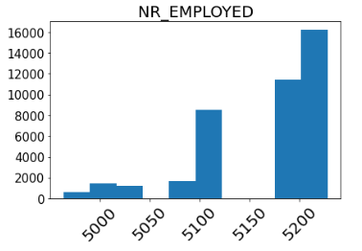
Univariate Analysis - Distribution of Feature Columns – Euribor3m, nr_employed
EURIBOR3M is left skewed with most observations having the value of 5.
NR_EMPLOYED also has a left skewed distribution with a tail stretching to the left side of mean. Most values are present at ~ 5200.
GO POKES | Mini Project Submission

Slide 9
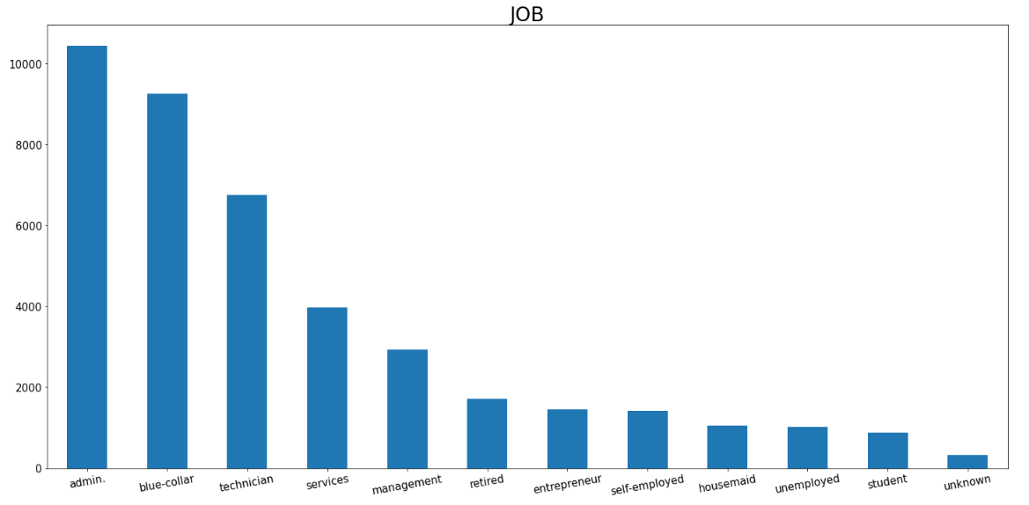
Univariate Analysis - Distribution of Feature Columns – Job
In JOB feature, the top three categories are:
Admin.
Blue-Collar
Technician
GO POKES | Mini Project Submission

Slide 10
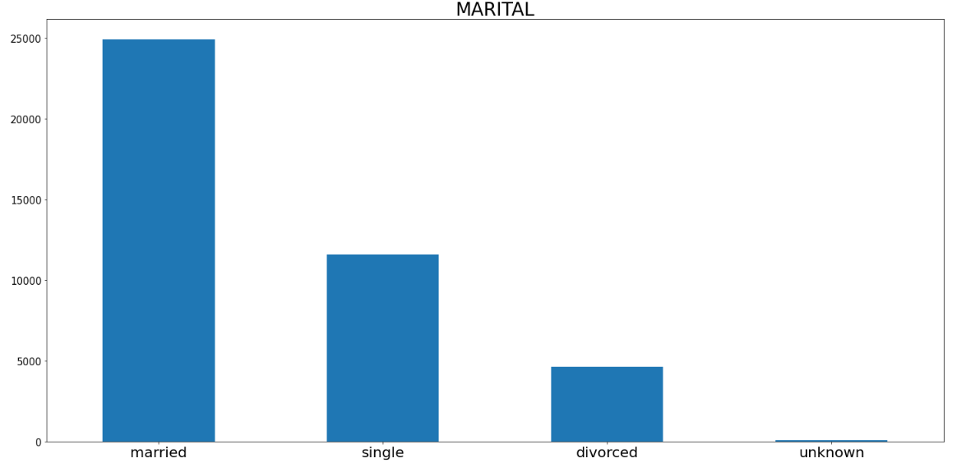
Univariate Analysis - Distribution of Feature Columns – Marital Status
Married was the most common category in the MARITAL feature
~60% of those called were married
GO POKES | Mini Project Submission

Slide 11
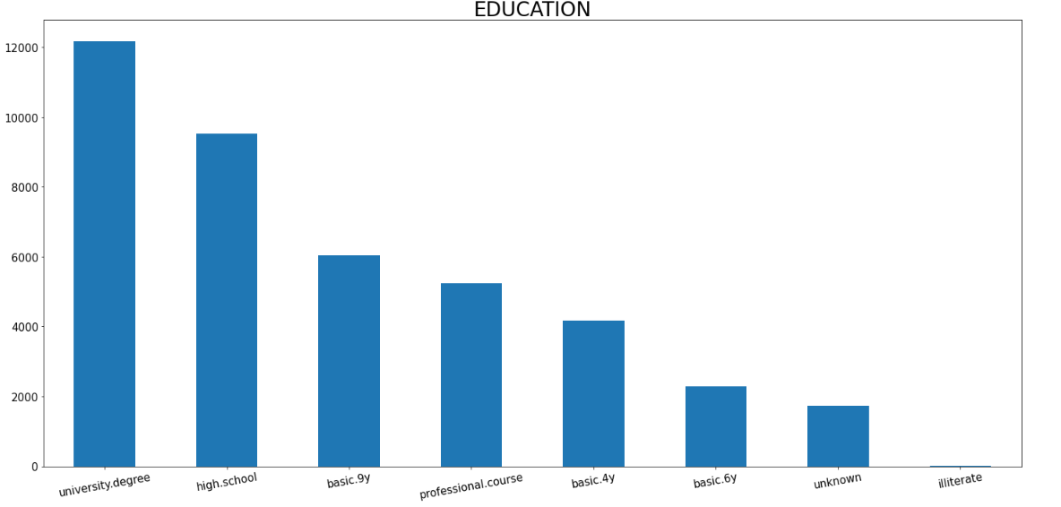
Univariate Analysis - Distribution of Feature Columns – Education
In EDUCATION feature, the top three categories are:
University degree
High school
Basic
GO POKES | Mini Project Submission

Slide 12
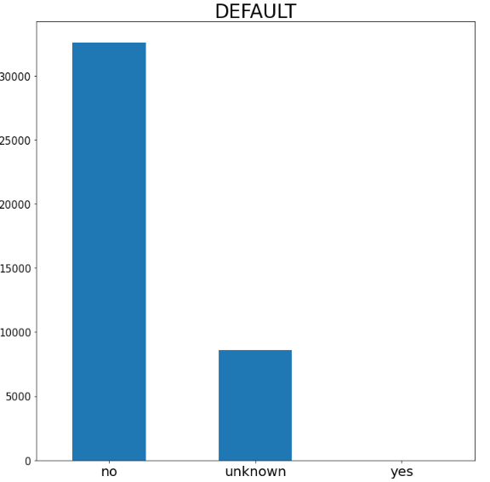
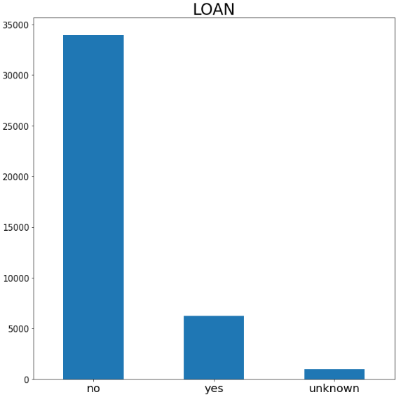
Univariate Analysis - Distribution of Feature Columns – default, loan
The most frequent value in DEFAULT is no. ~80% of the values are classified as no
Similarly, in LOAN, the most common value is also no. ~78% of the values are classified as no
GO POKES | Mini Project Submission

Slide 13
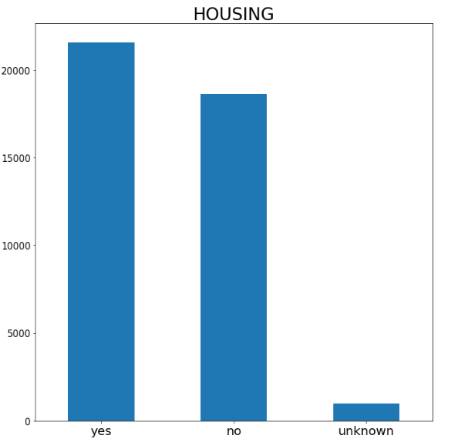
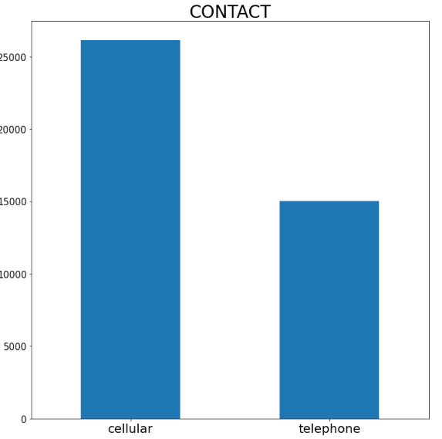
Univariate Analysis - Distribution of Feature Columns – Housing, Contact
In HOUSING the distribution, there is an even spread between yes and no. This feature has an entropy close to 1
For CONTACT, "cellular" has more values than "telephone;" however the difference is not that significant
GO POKES | Mini Project Submission

Slide 14
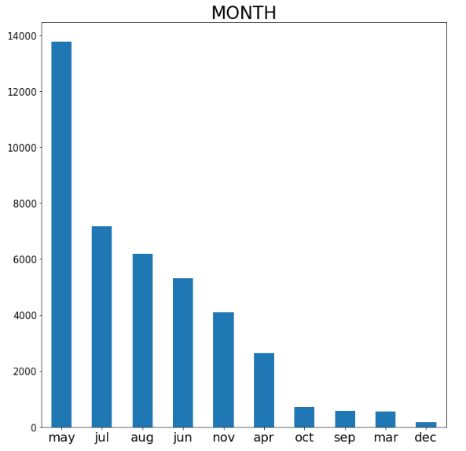
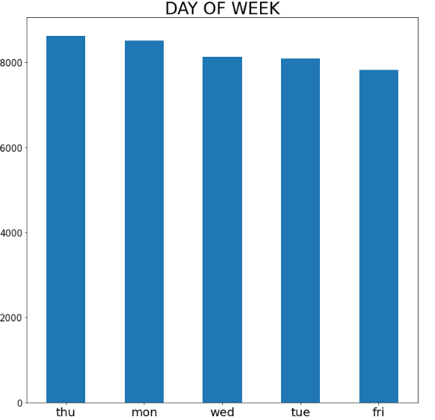
Univariate Analysis - Distribution of Feature Columns – month, day_of_week
In MONTH, the top 3 values are:
May
Jul
Aug
For DAY OF WEEK, most frequent 3 values are:
Thu
Mon
Wed
GO POKES | Mini Project Submission

Slide 15
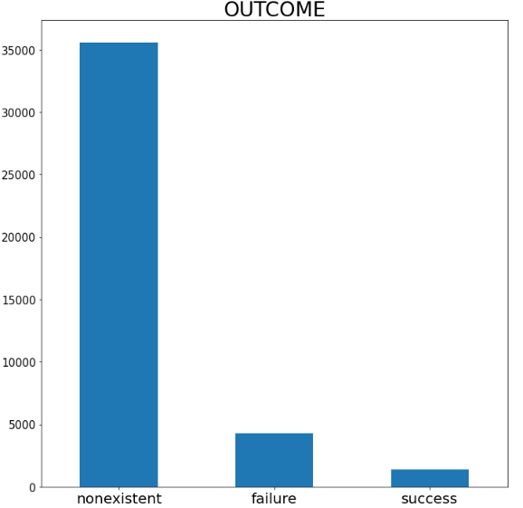
Univariate Analysis - Distribution of Feature Columns – Outcome
In the OUTCOME variable, the most frequent value is non-existent.
~84% of the values fall in the non-existent category.
GO POKES | Mini Project Submission

Slide 16
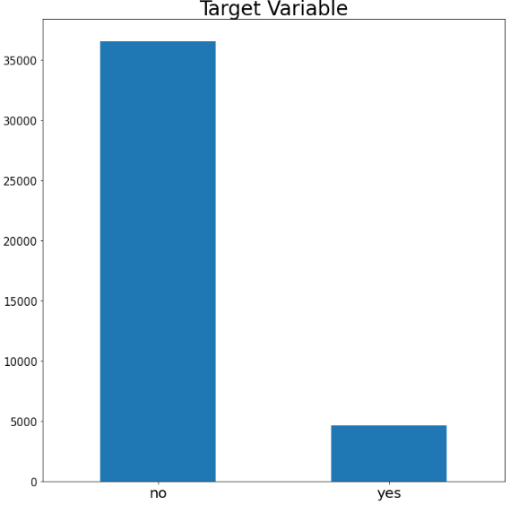
Univariate Analysis - Distribution of Feature Columns – Target Variable ( Yes / No )
Finally, the target variable is skewed to the value no,
~36,000 values are no.
~5,000 values are yes.
GO POKES | Mini Project Submission

Slide 17
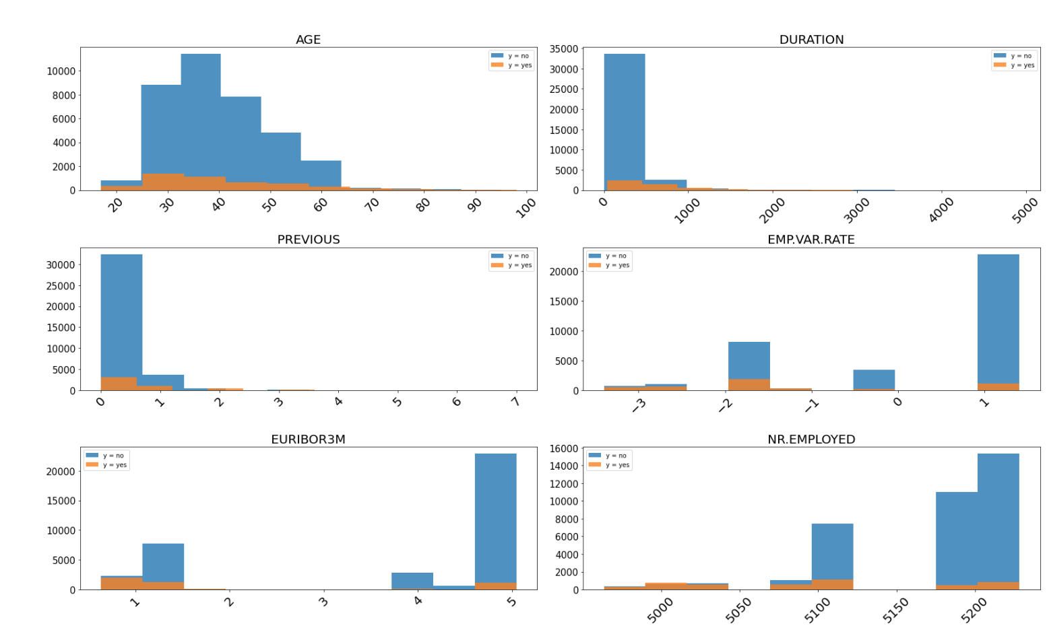
Bivariate Analysis- Feature Columns – Target Variable ( Yes / No )
GO POKES | Mini Project Submission

Slide 18
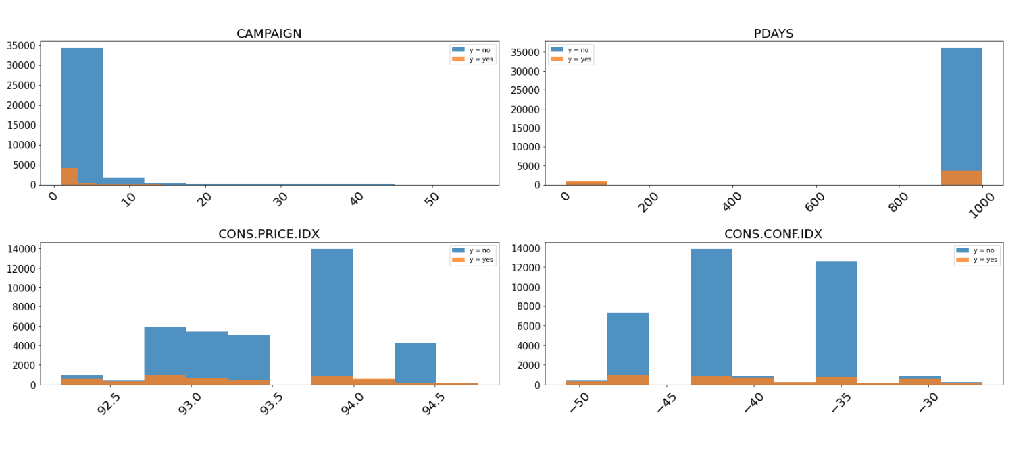
Bivariate Analysis- Feature Columns – Target Variable ( Yes / No )
GO POKES | Mini Project Submission

Slide 19
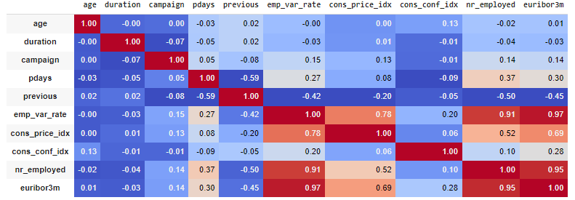
Multivariate Analysis - Correlation Analysis b/w Numeric Variables
From the correlation heatmap, we see a high degree of correlation between the variables euribor3m, nr_employed, emp_var_rate. Hence, we have removed euribor3m, nr_employed from further analysis.
GO POKES | Mini Project Submission

Slide 20
Classification Models

Slide 21
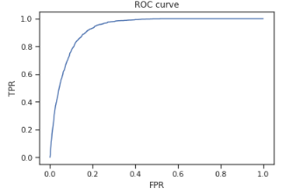
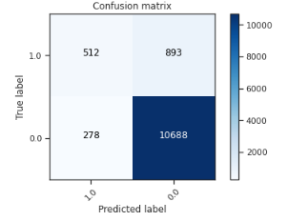
Model 1 – Logistic Regression Classifier
ROC AUC Score – 0.9310
In Logistic Regression Model:
In ROC curve, we attained a score of 0.9310.
In the confusion matrix, we have 10,688 classified as the TRUE NEGATIVE, or non-subscribing.
This is our baseline model.
GO POKES | Mini Project Submission

Slide 22
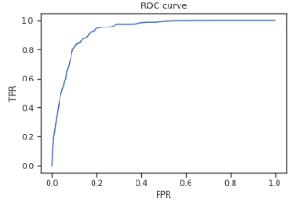

Model 2 – Random Forest Classifier
ROC AUC Score – 0.9327
In Random Forest Model:
In ROC curve, we attained a score of 0.9327.
In the confusion matrix, we have 10,885 classified as the TRUE NEGATIVE, or non-subscribing.
These results are better than the baseline logistic regression model.
GO POKES | Mini Project Submission

Slide 23
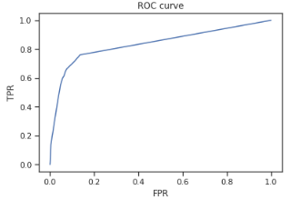
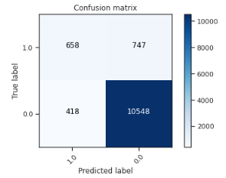
Model 3 – Decision Tree Classifier
ROC AUC Score – 0.8357
In Decision Tree Model:
In ROC curve, we attained a score of 0.8357.
In the confusion matrix, we have 10,548 classified as the TRUE NEGATIVE, or non-subscribing.
These results are worse than the baseline logistic regression model.
GO POKES | Mini Project Submission

Slide 24

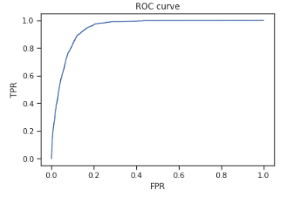
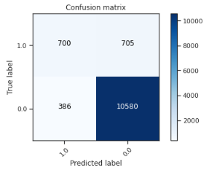
Model 4 – Gradient Boosting Classifier
ROC AUC Score – 0.9443
In Gradient Boosting Model:
In ROC curve, we attained a score of 0.9443.
In the confusion matrix, we have 10,580 classified as the TRUE NEGATIVE, or non-subscribing.
These results are by far the best results and are significantly better than the baseline logistic regression model.
GO POKES | Mini Project Submission

Slide 25
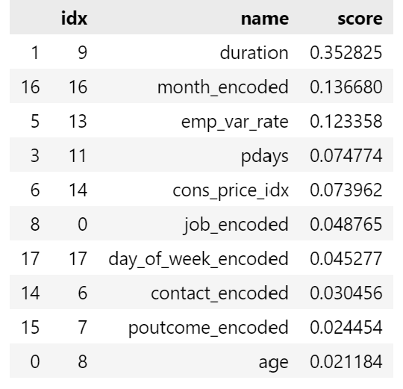
Feature Importance – Gradient Boosting Classifier
We found out that ‘duration’, ‘month’ and ‘emp_var_rate’ are the 3 most important variables when identifying clients who will subscribe for a term deposit.
There might be a higher chance of a person subscribing to the term deposit plan if the duration of the call is significantly higher.
Also, emp_var_rate as per the teams’ understanding is an indicator of the hiring and firing due to the shifts in the conditions of economy. A negative rate might not allow a bank to receive a lot of subscribers to their term deposit plan.
GO POKES | Mini Project Submission

Slide 26
K-Means Clustering

Slide 27
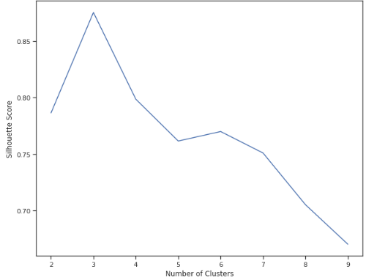
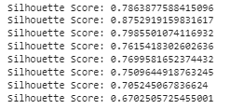
K-Means Clustering
Silhouette score for a set of sample data points is used to measure how dense and well-separated the clusters are. The most optimum number of clusters as per the Silhouette score is 3.
GO POKES | Mini Project Submission

Slide 28
THANK YOU
GO POKES | Mini Project Submission

